Slide 1
Programmable logic array(PLA) and MSI based design

Slide 2
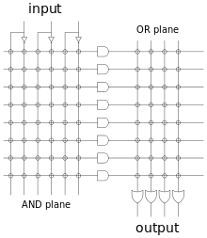

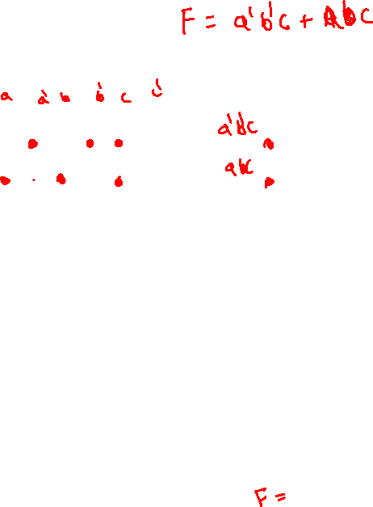
PLA programmable And, programmable OR

Slide 3
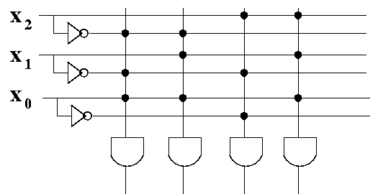
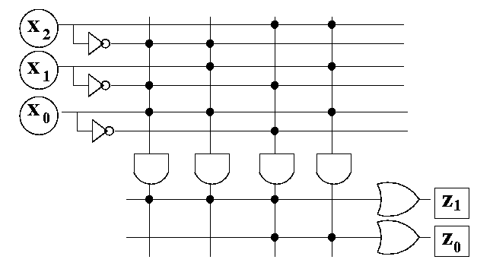
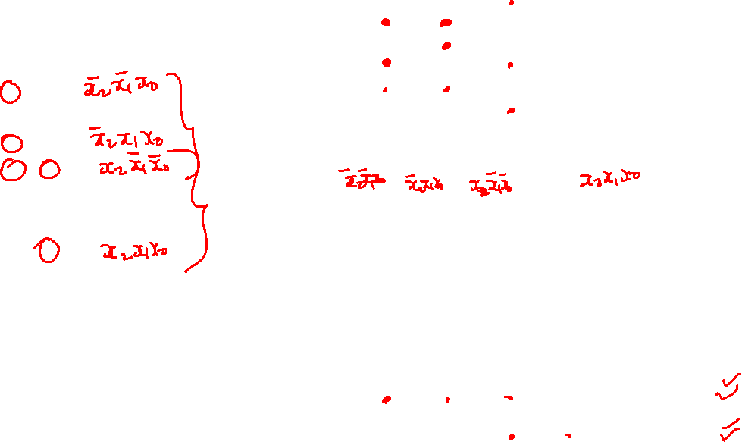
PLA design
x₂ | x₁ | x₀ | z₁ | z₀
0 | 0 | 0 | 0 | 0
0 | 0 | 1 | 1 | 0
0 | 1 | 0 | 0 | 0
0 | 1 | 1 | 1 | 0
1 | 0 | 0 | 1 | 1
1 | 0 | 1 | 0 | 0
1 | 1 | 0 | 0 | 0
1 | 1 | 1 | 0 | 1

Slide 4
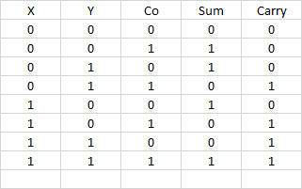
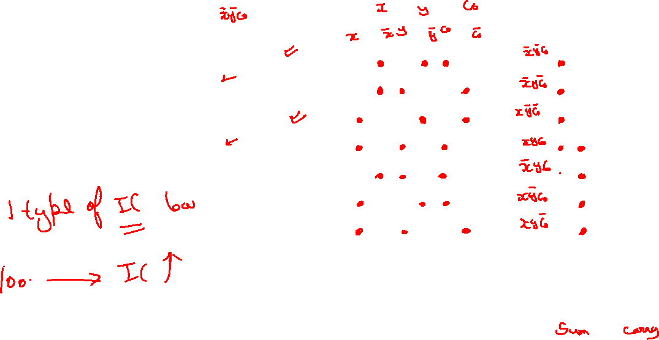

Slide 5
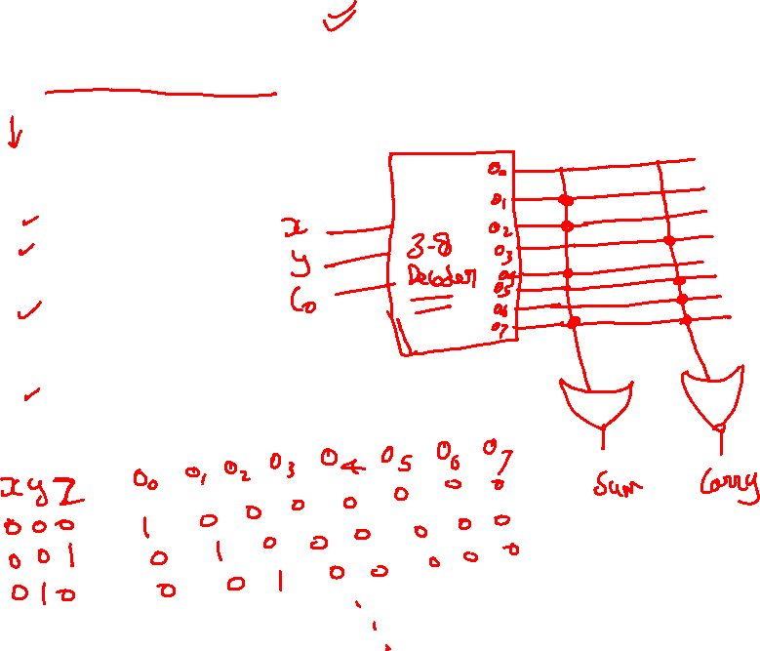
Full adder using 3-8 decoder

Slide 6
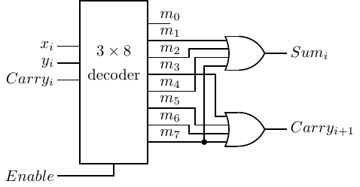
MSI based Design Full adder using 3-8 decoder

Slide 7

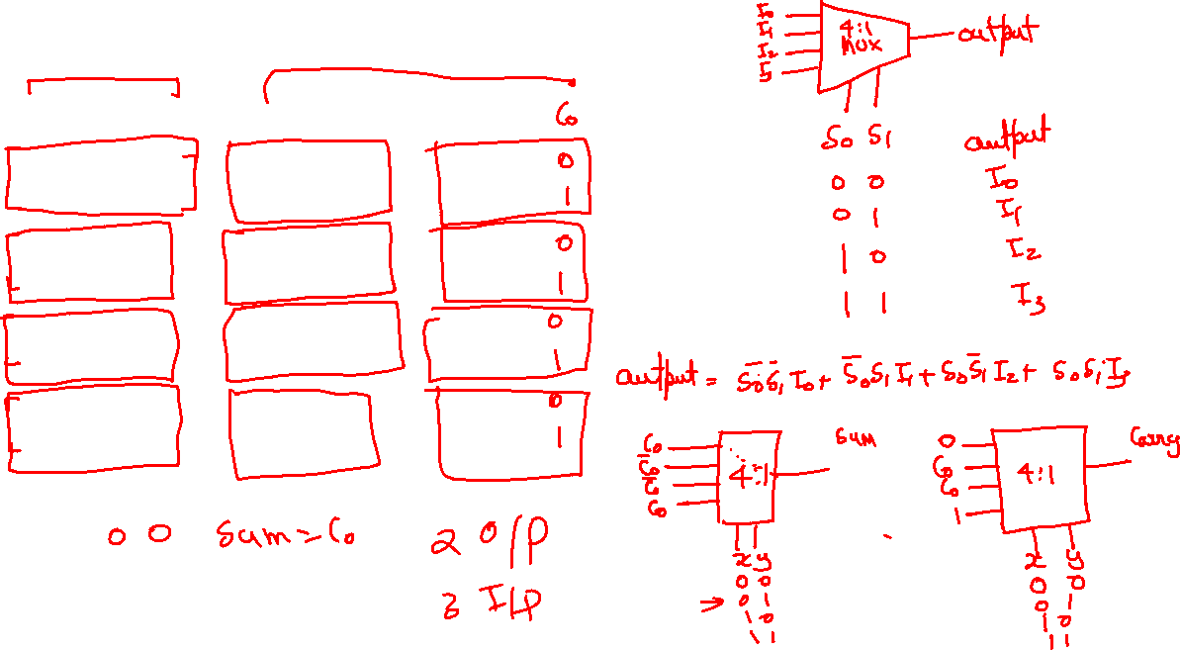
Full adder using MUX

Slide 8
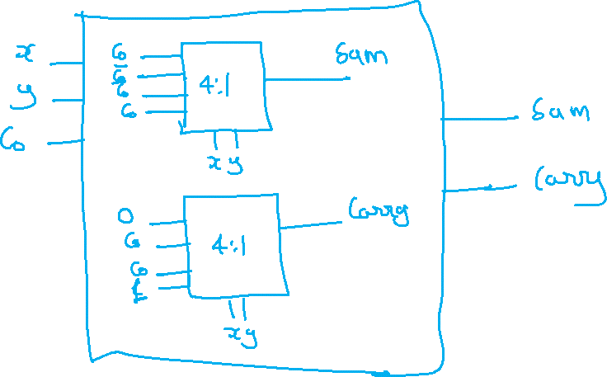
Full adder using MUX

